Slide 1
Digital baja hackathon
Roberto Espinosa

Slide 2
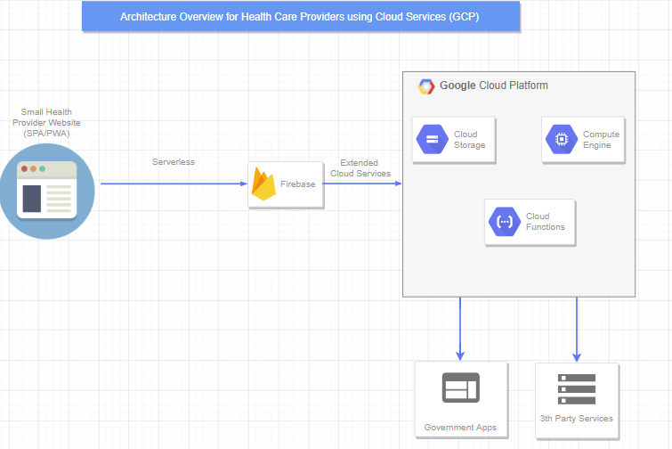
Unify healthcare data
Data analytics
Collaboration
https://bcdhackathon.firebaseapp.com

Slide 3
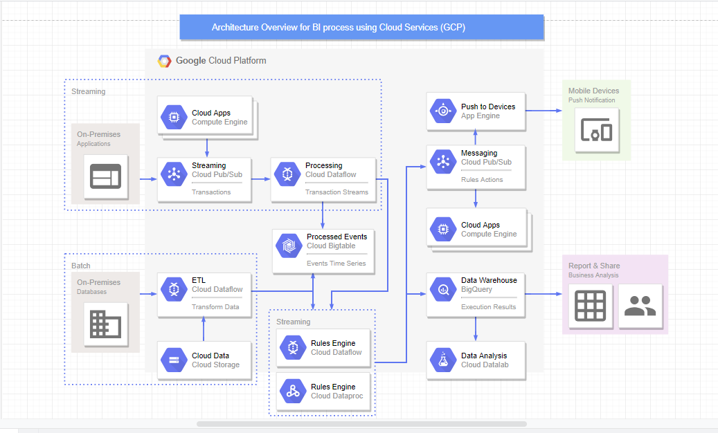
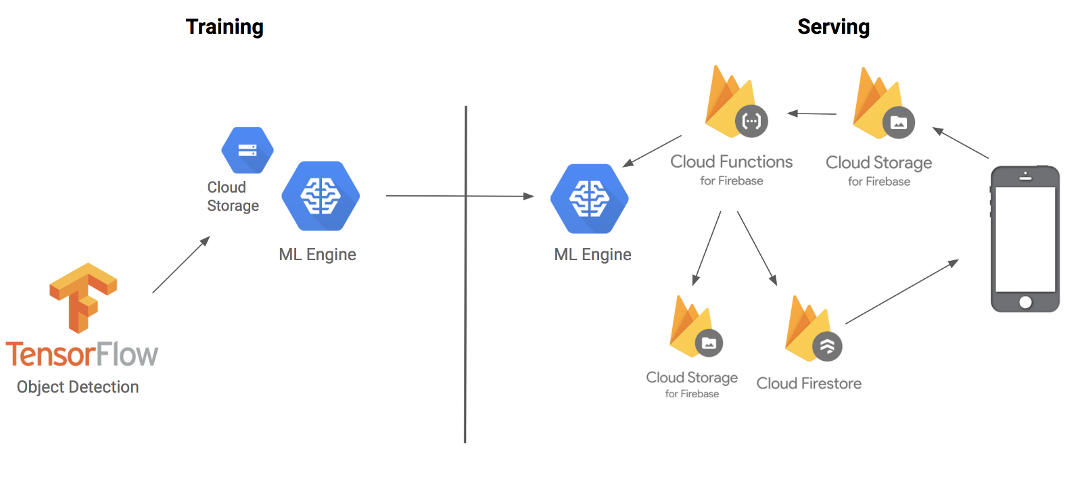
BI
Machine learning
AI

Slide 4
Healthcare website/Cloud computing (ai/ml)
Reduce difficulties on operations and improve patient experience by storing and accessing data from one place.
Provide Real-Time Communication with collaborators and specialist using cutting edge technologies.
Provide meaningfully insights by using cloud computing to analyze large amount of data, Machine Learning and AI techniques.
Provide BI for KPI’s in order to take smart decisions.
Reduce Infrastructure, space and paper by moving operations to the Cloud.

Slide 5

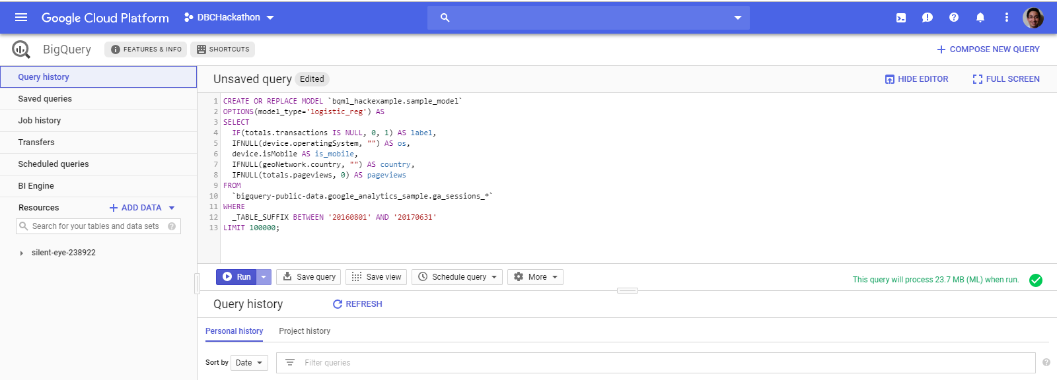
BIQQUERY Example

Slide 6
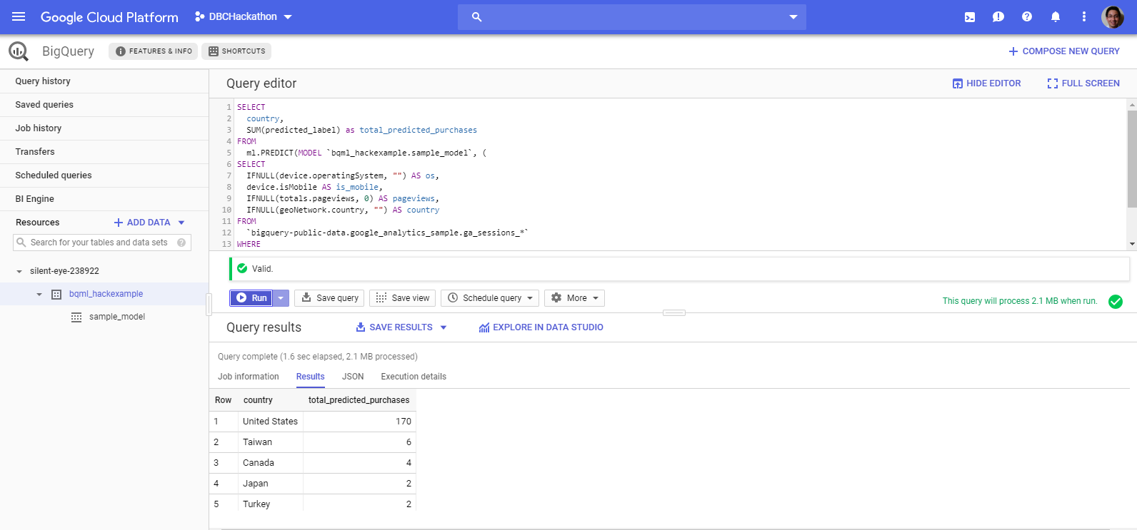
BIQQUERY Example

Slide 7
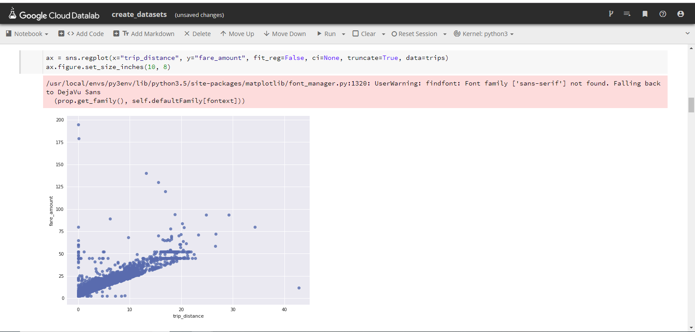
Google cloud data lab (ML example)

Slide 8
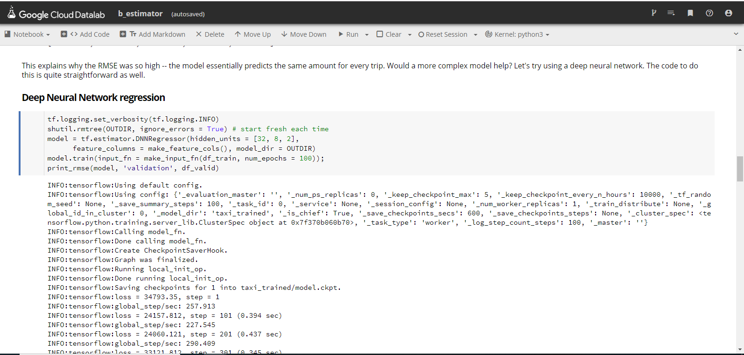
Google cloud data lab (Tensorflow example)

Slide 9
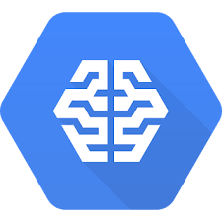



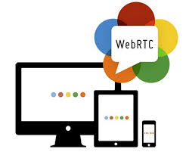
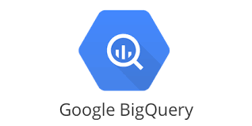
technologies

